Slide 1
Drift Correction: Initial Results
Luhang Sun, Deka Popov, Bret Miller, Sidney Liu

Slide 2
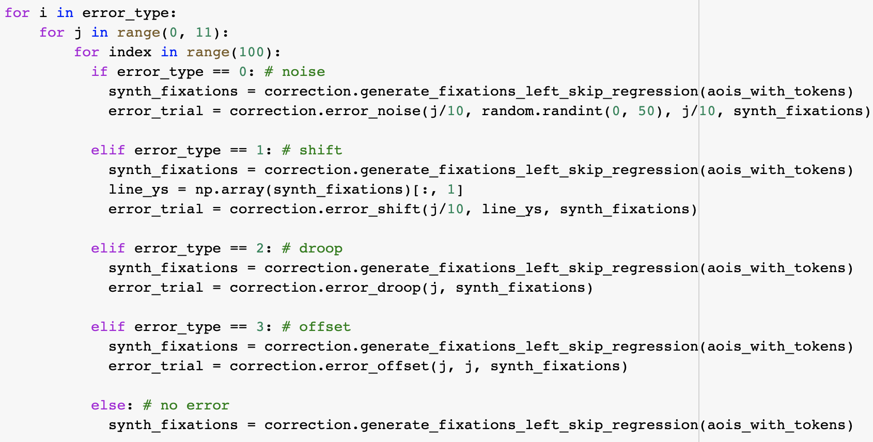
Synthetic Dataset
Notes:
Deka

Slide 3
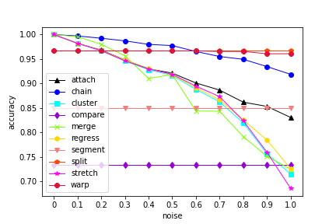
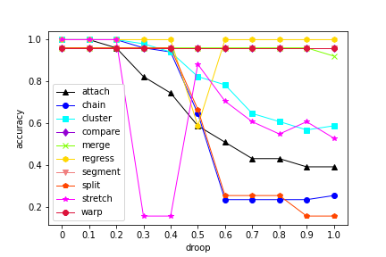
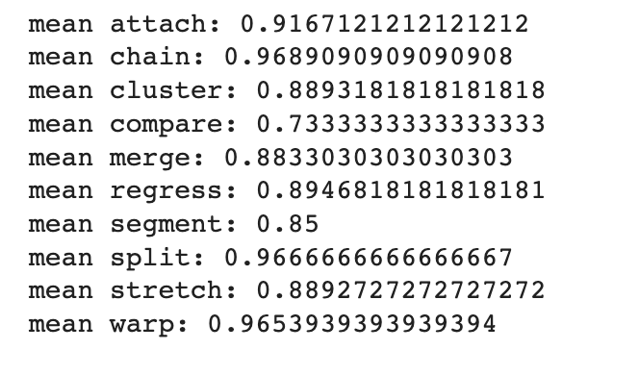
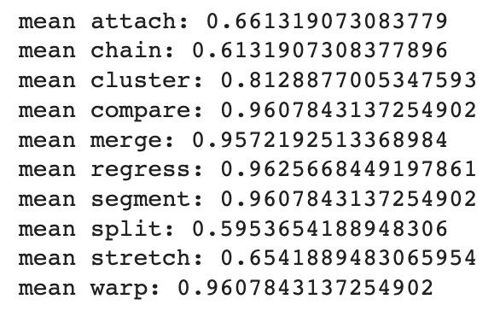
Algorithm Accuracy on Synthetic Data (noise, droop)
Notes:
Deka

Slide 4
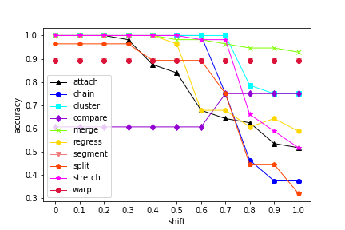
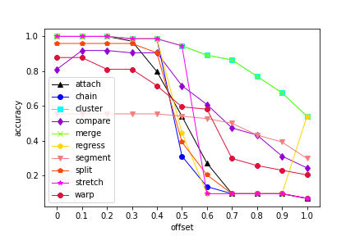
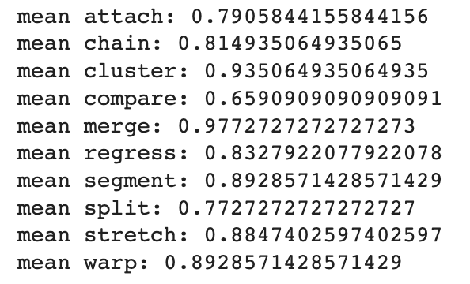
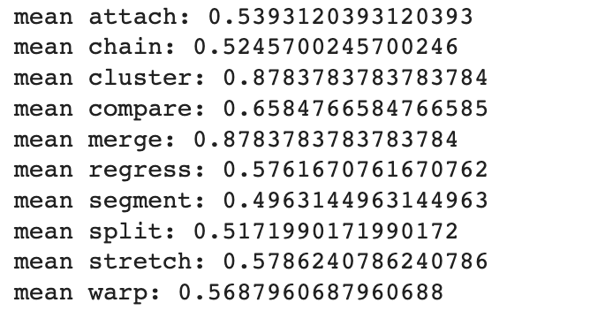
Algorithm Accuracy on Synthetic Data (shift, offset)

Slide 5
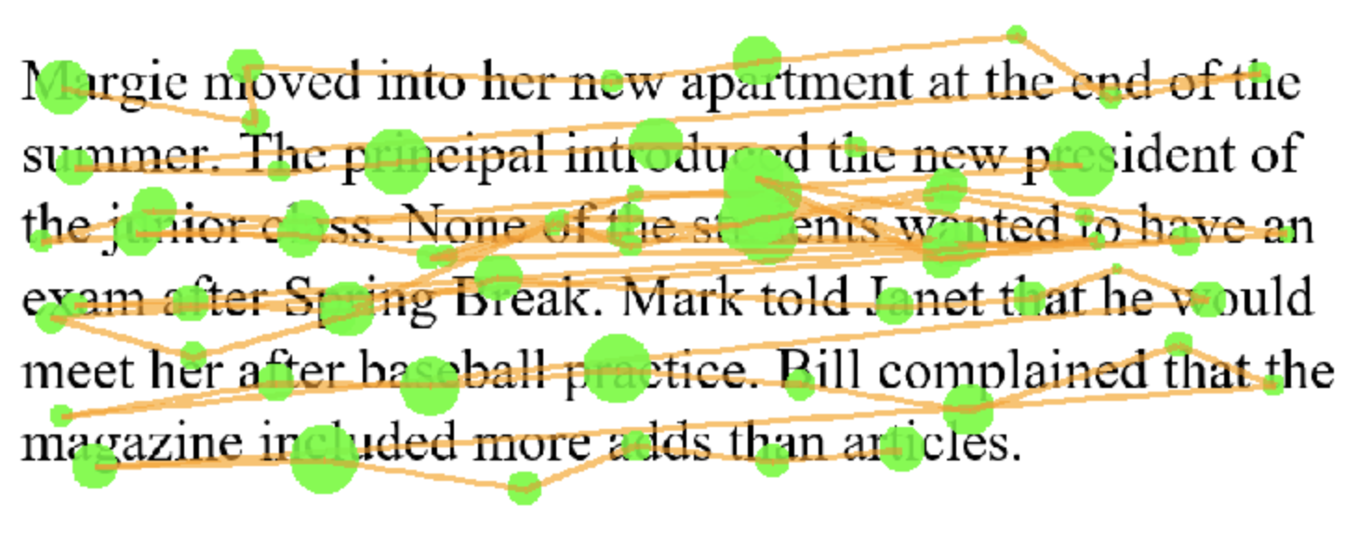
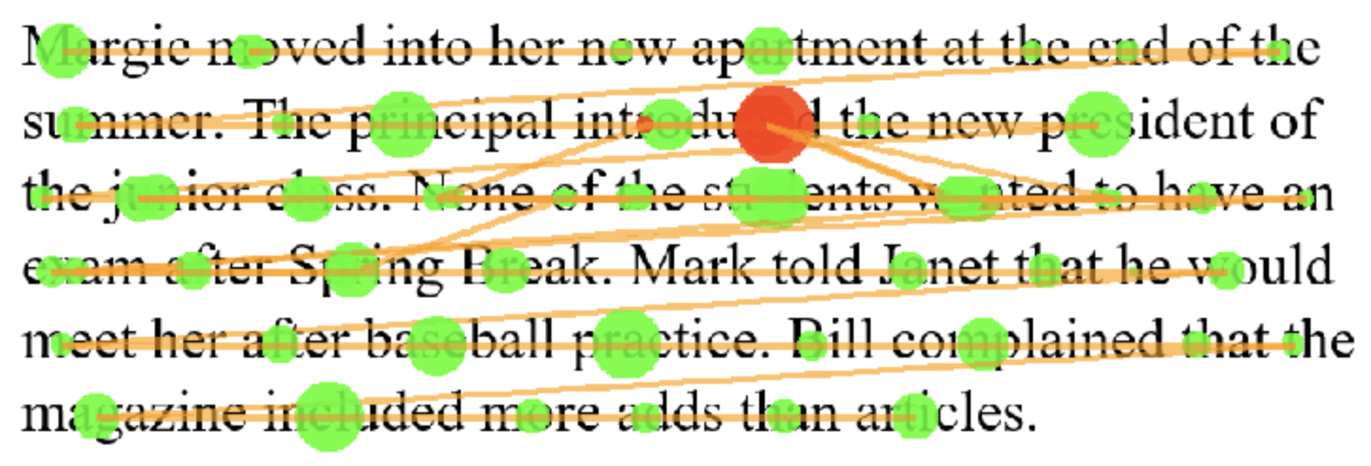
Synthetic Data Correction: Noise (chain algo)

Slide 6
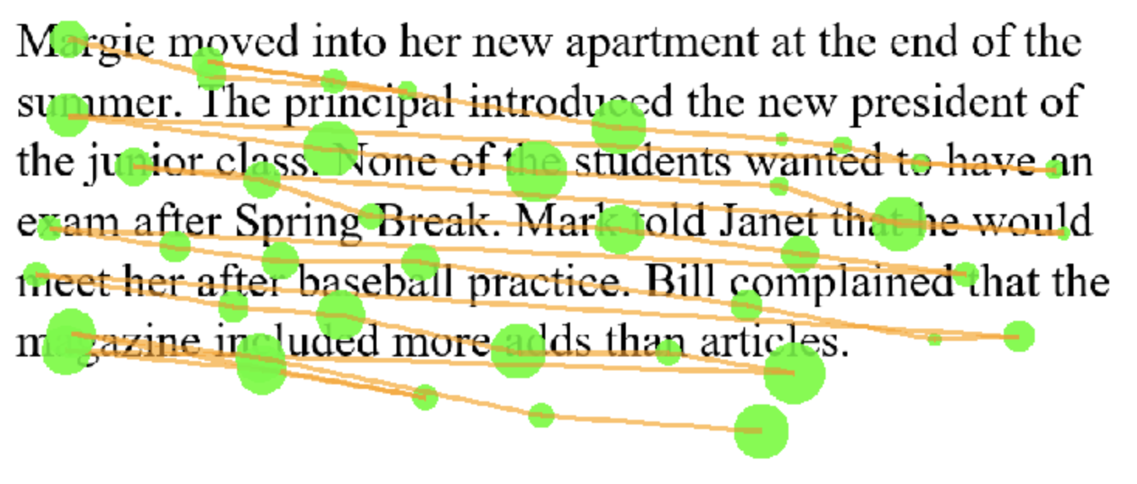
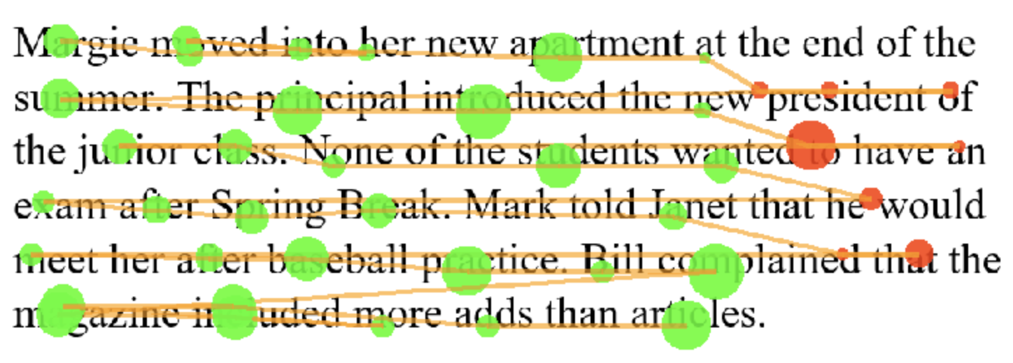
Synthetic Data Correction: Droop (regress algo)

Slide 7
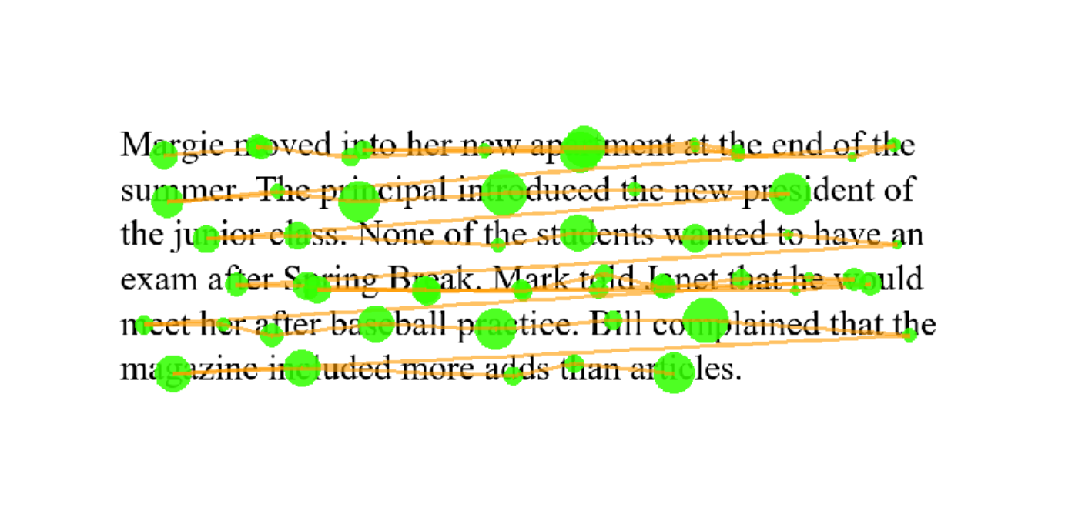
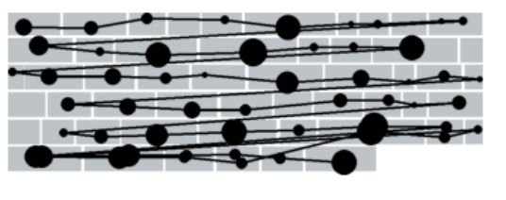
Input Generalization for Neural Network
“Grey-box” to represent text
Trimmed image
Notes:
Luhang

Slide 8
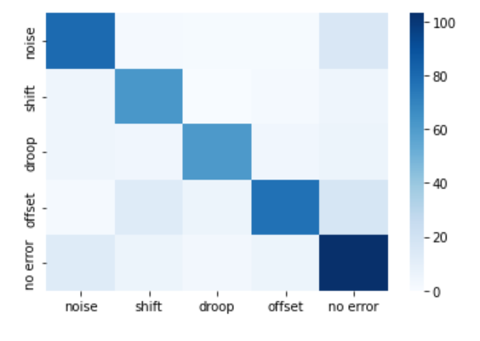
NN Classifier Accuracy
Epochs = 30; batch_size = 30
Loss in validation/testing accuracy after switching to the “grey-box” model
~97% training, ~75% testing accuracy
Notes:
Luhang

Slide 9
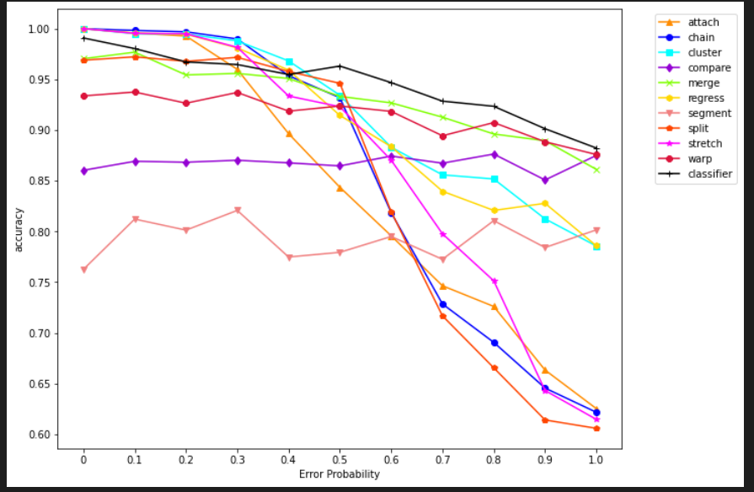
Did classification help correction?
The average of all four types of errors repeated for 30 times (120 samples) at each probability
With random regression and skipping
The relatively low accuracy of the model with classifier is mainly due to low prediction accuracy when probability is low
Low probabilities of errors confuse the classifier to predict as “no error” -> no correction
Notes:
Luhang

Slide 10
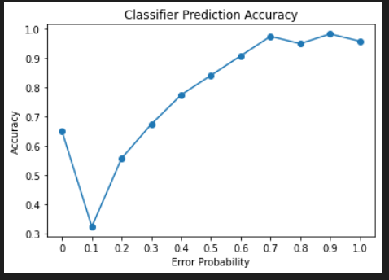
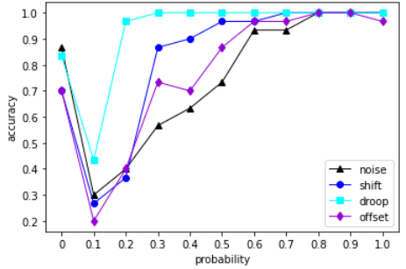
Classifier’s confusion at low error probability
0 probability of error -> no error as correct label
The NN classifier tends to predict trials with low error probability as “no-error”

Slide 11
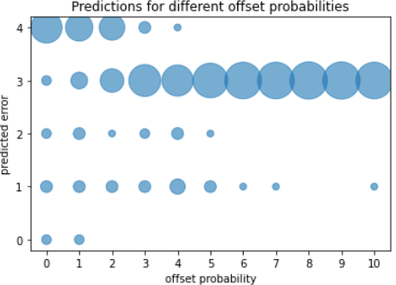
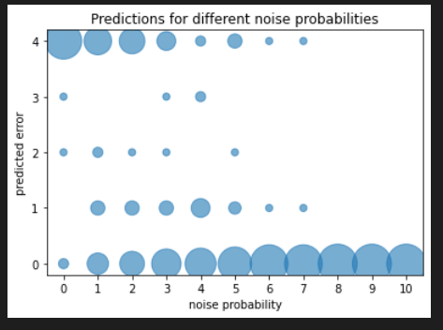
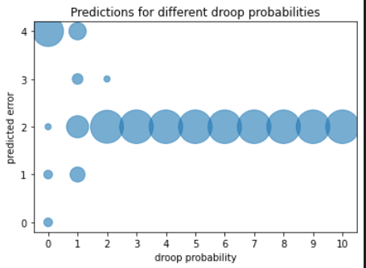
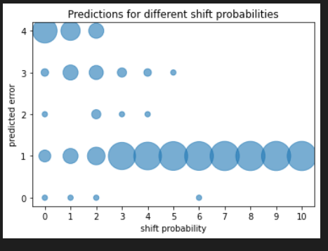

Slide 12
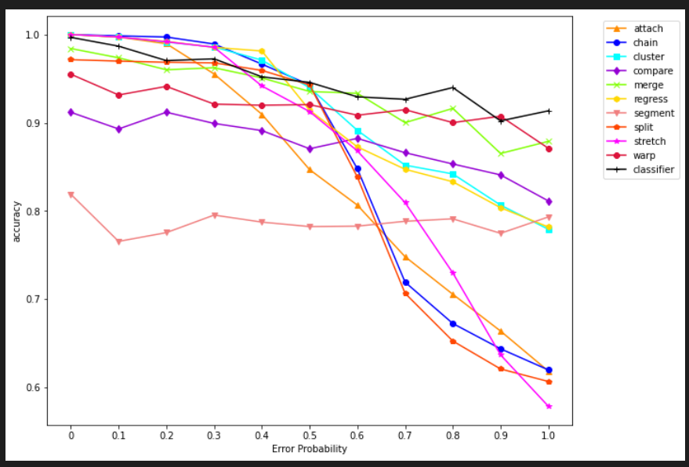
Use “chain” when predicted as “no error”

Slide 13
Golden Set Generation
Used Fix8 to correct each trial
Created a set of Json files to be used as the “ground truth” for our dataset
Consisted of 15 different trials to comprise the Golden Set
Was time intensive, but gave insight into how different peoples reading behavior is
Helped us understand the way that different real world drift phenomena occur in actual eye tracking trials
Notes:
Bret

Slide 14
Correction Accuracy on GazeBase
We utilized the original algorithms to see how they would perform on real world data
Based on Carr’s paper, we knew that the accuracy would not be as good as on the synthetic data
At first, I was receiving 0,1,2% in terms of accuracy, but one of my partners figured out where the bug was
In addition, I ran every single trial, through every single algorithm to find the performance across all the trials
This allowed for us to compare how they fared against each other when it came to working with real world data, which usually had every type of error present.
Notes:
Bret

Slide 15
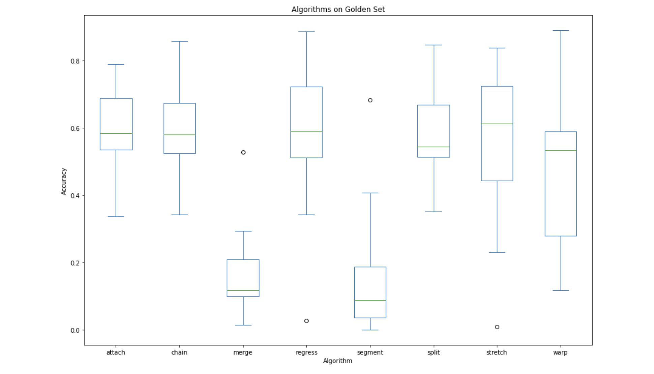
Correction Accuracy

